Slide 1
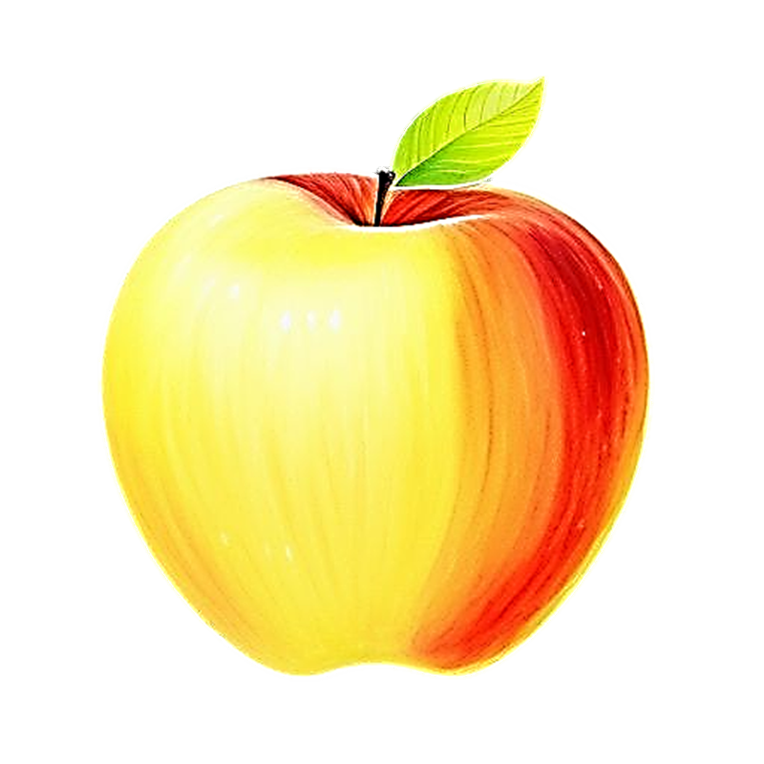

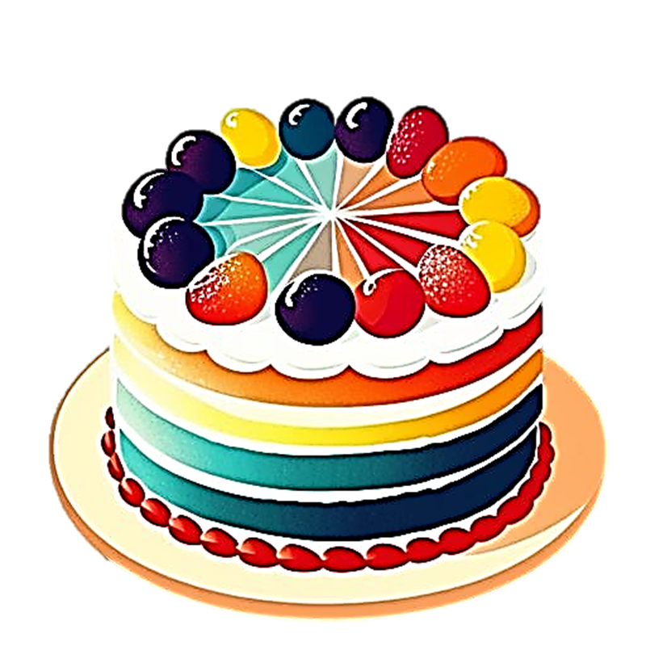

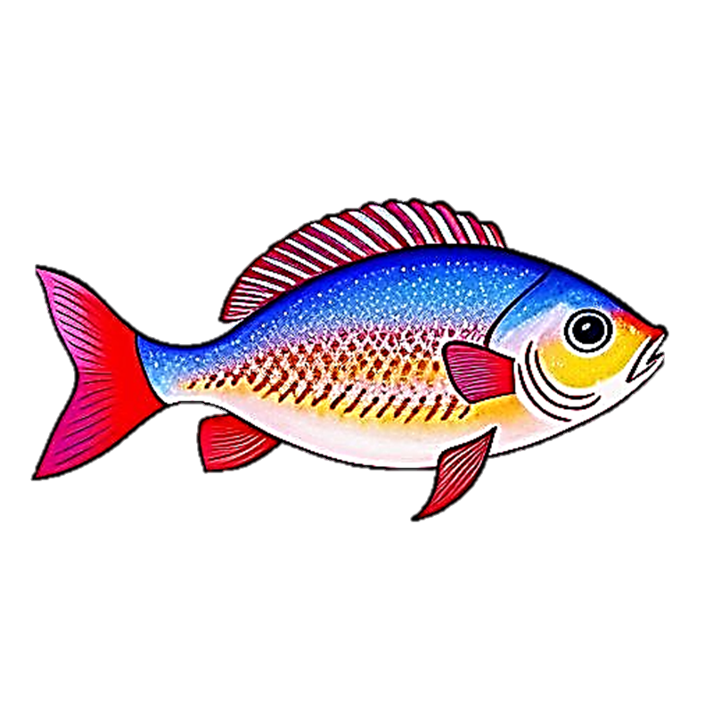
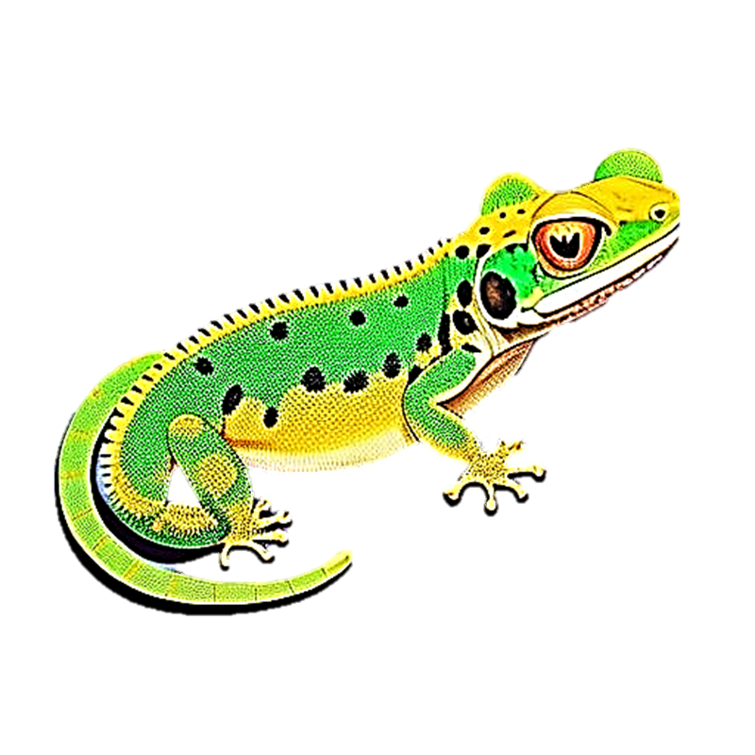



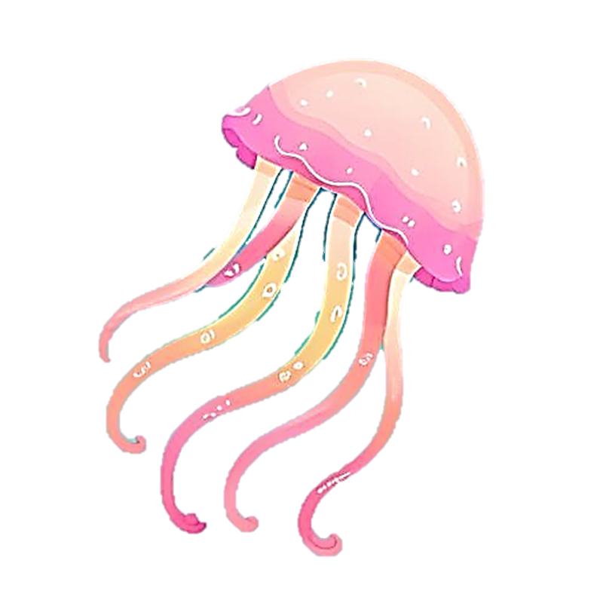
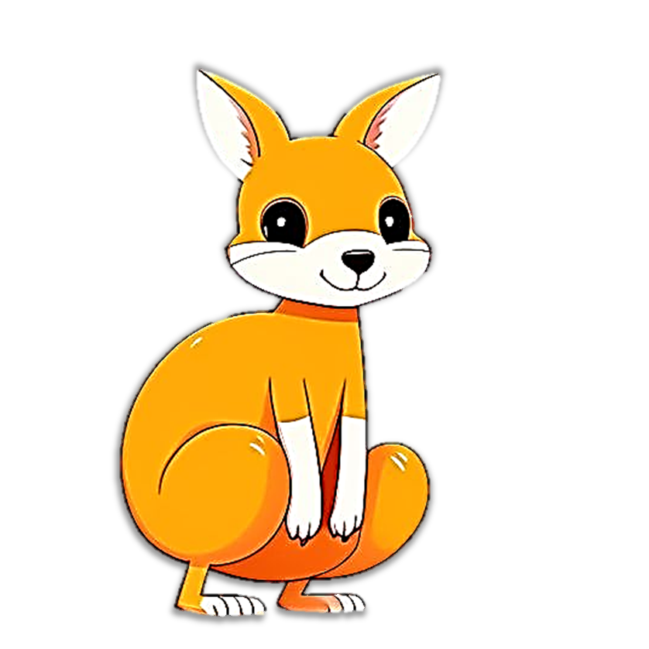

I can write Alphabet
Tracing Book
Aa
Bb
Cc
Dd
Ee
Ff
Gg
Hh
I i
Jj
Kk
L l

Slide 2
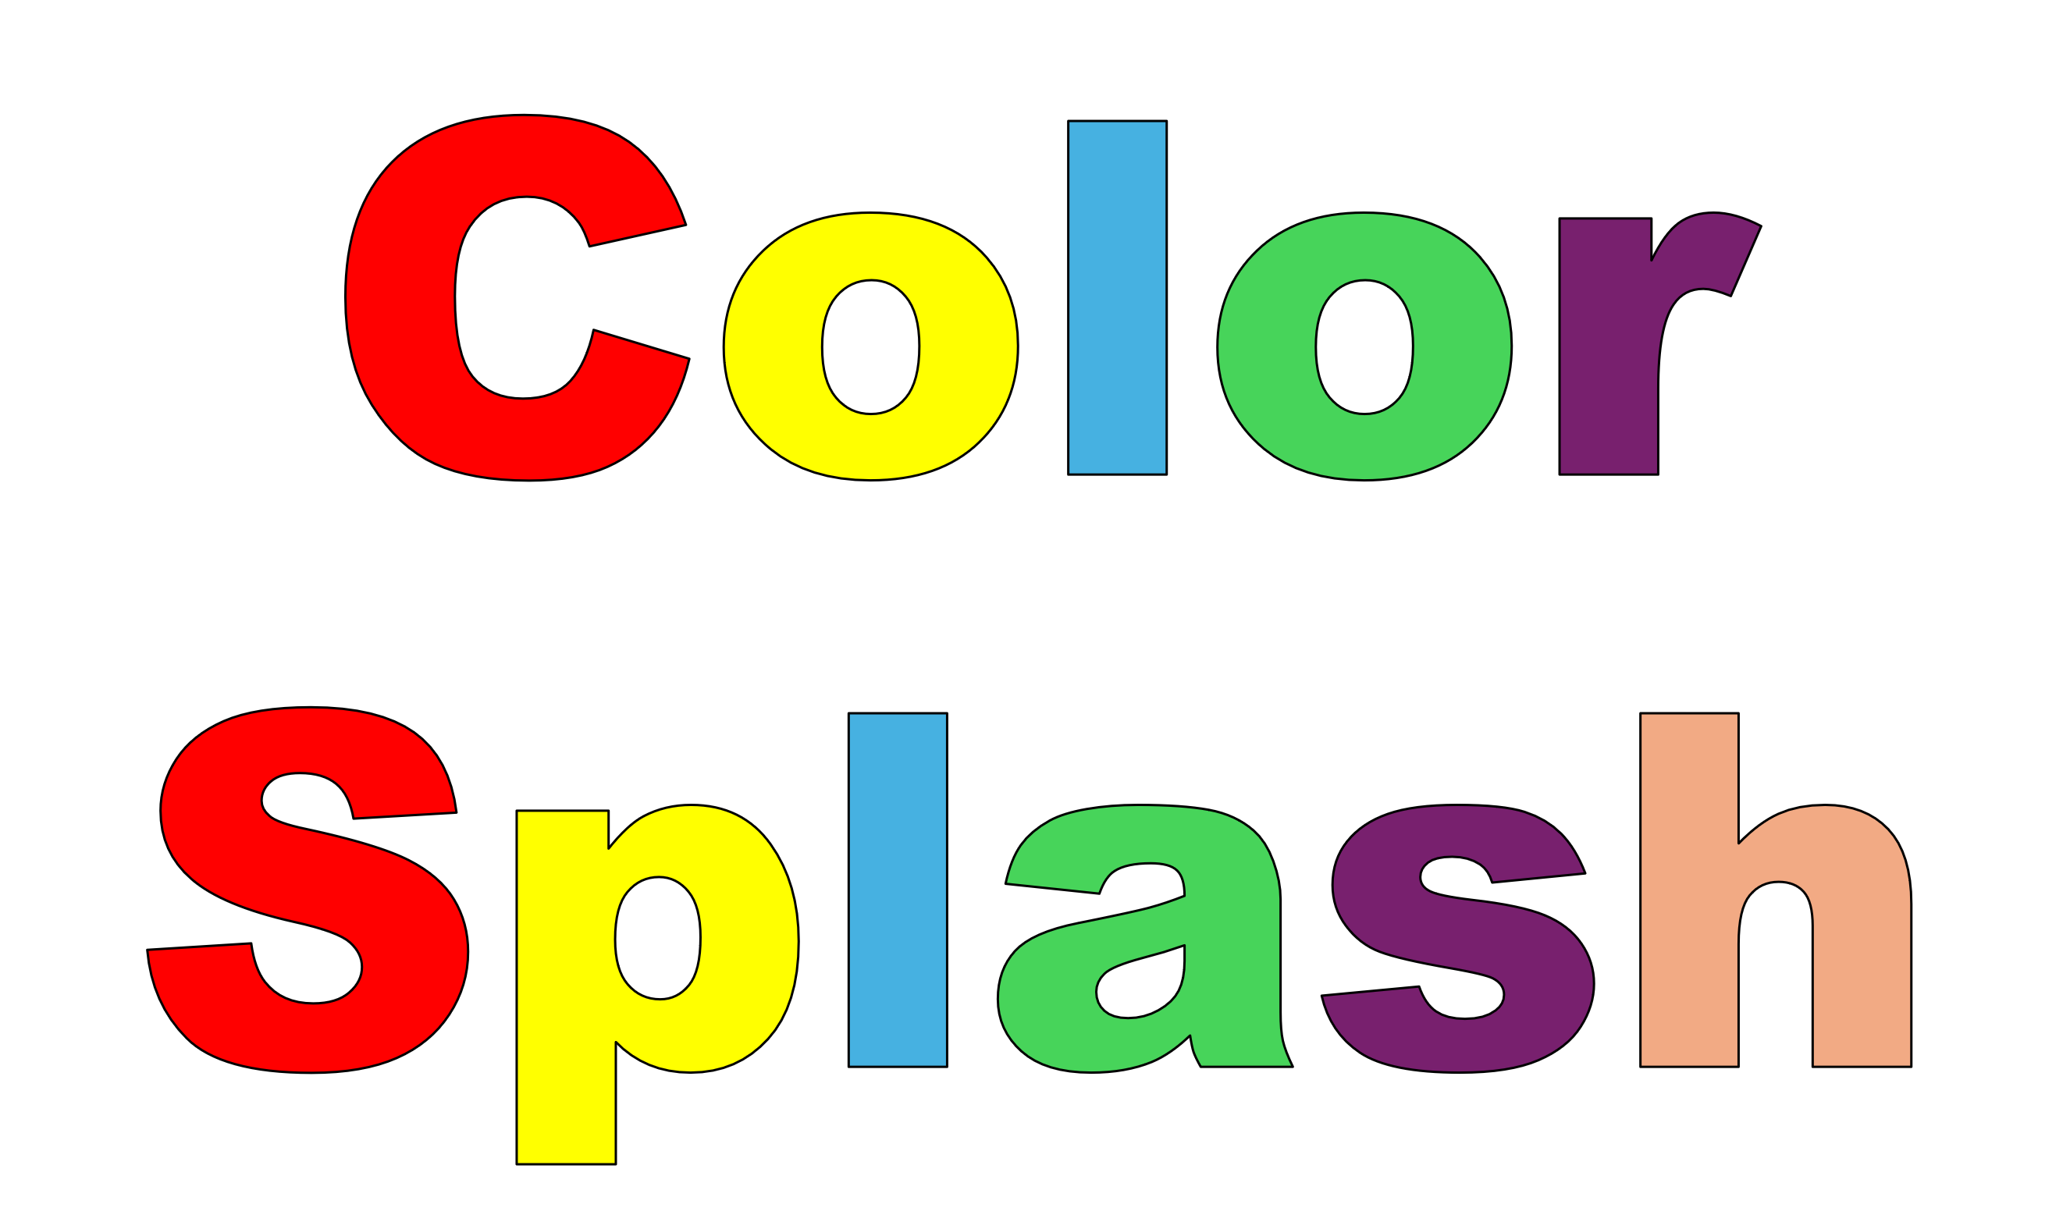
Color Splash
A a
Blossomings.github.io
Aa Aa Aa Aa Aa Aa
Aa Aa Aa Aa Aa Aa
Color Splash
Aa Aa Aa Aa Aa Aa

Slide 3
B b
Blossomings.github.io
Bb Bb Bb Bb Bb Bb
Bb Bb Bb Bb Bb Bb
Color Splash
Bb Bb Bb Bb Bb Bb

Slide 4
C c
Blossomings.github.io
Cc Cc Cc Cc Cc Cc
Cc Cc Cc Cc Cc Cc
Color Splash
Cc Cc Cc Cc Cc Cc

Slide 5
D d
Blossomings.github.io
Dd Dd Dd Dd Dd Dd
Color Splash
Dd Dd Dd Dd Dd Dd
Dd Dd Dd Dd Dd Dd

Slide 6
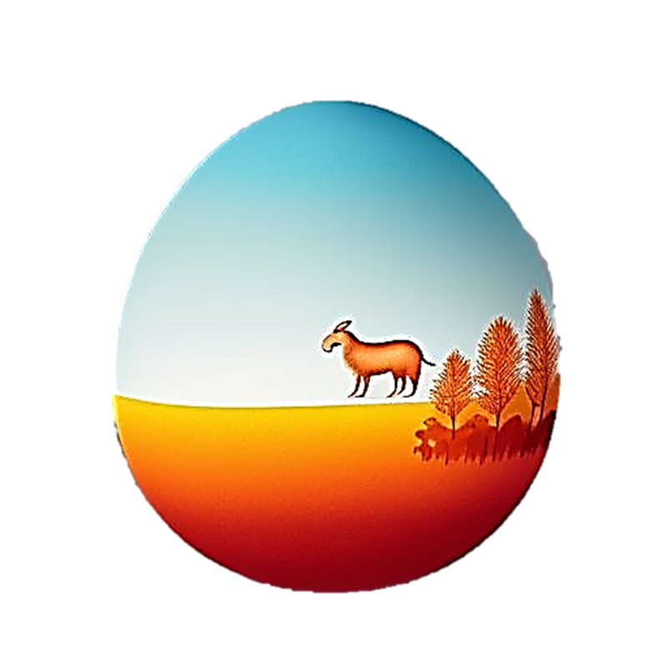
E e
Blossomings.github.io
Ee Ee Ee Ee Ee Ee
Ee Ee Ee Ee Ee Ee
Color Splash
Ee Ee Ee Ee Ee Ee

Slide 7
F f
Blossomings.github.io
Ff Ff Ff Ff Ff Ff
Color Splash
Ff Ff Ff Ff Ff Ff
Ff Ff Ff Ff Ff Ff

Slide 8
G g
Blossomings.github.io
Gg Gg Gg Gg Gg Gg
Gg Gg Gg Gg Gg Gg
Color Splash
Gg Gg Gg Gg Gg Gg

Slide 9
H h
Blossomings.github.io
Hh Hh Hh Hh Hh Hh
Hh Hh Hh Hh Hh Hh
Color Splash
Hh Hh Hh Hh Hh Hh

Slide 10
I i
Blossomings.github.io
Ii Ii Ii Ii Ii Ii Ii Ii Ii Ii Ii
Ii Ii Ii Ii Ii Ii Ii Ii Ii Ii Ii
Color Splash
Ii Ii Ii Ii Ii Ii Ii Ii Ii Ii Ii

Slide 11
J j
Blossomings.github.io
Jj Jj Jj Jj Jj Jj Jj
Jj Jj Jj Jj Jj Jj Jj
Color Splash
Jj Jj Jj Jj Jj Jj Jj

Slide 12
K k
Blossomings.github.io
Kk Kk Kk Kk Kk Kk
Kk Kk Kk Kk Kk Kk
Color Splash
Kk Kk Kk Kk Kk Kk

Slide 13
L l
Blossomings.github.io
Ll Ll Ll Ll Ll Ll Ll Ll
Ll Ll Ll Ll Ll Ll Ll Ll
Color Splash
Ll Ll Ll Ll Ll Ll Ll Ll

Slide 14
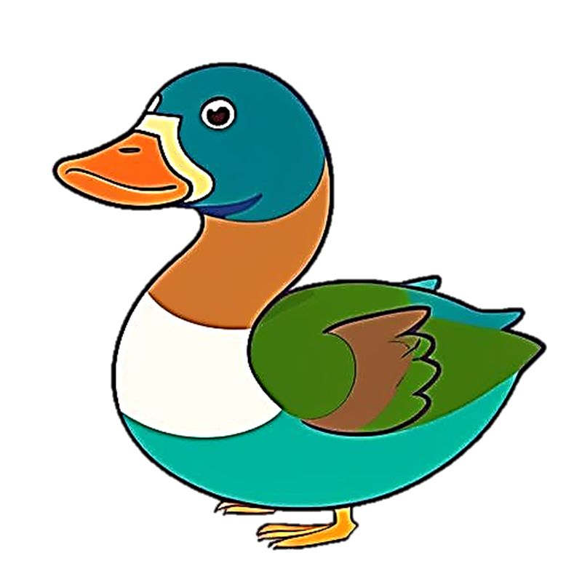
M m
Blossomings.github.io
Mm Mm Mm Mm Mm
Mm Mm Mm Mm Mm
Color Splash
Mm Mm Mm Mm Mm

Slide 15
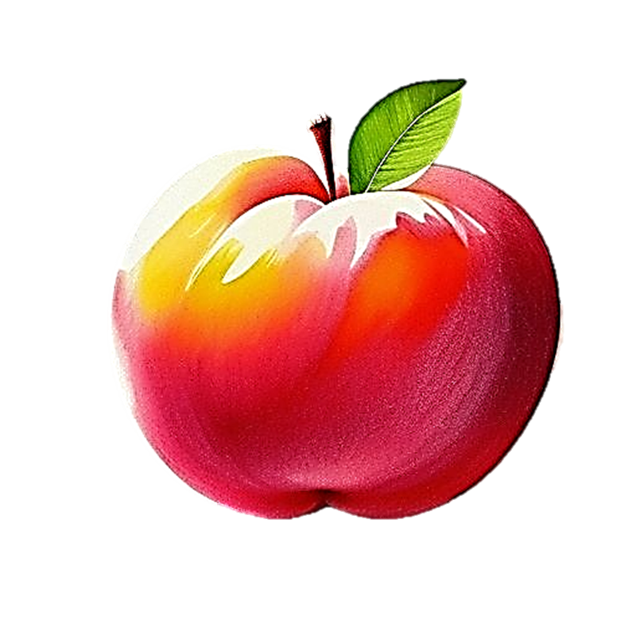
N n
Blossomings.github.io
Nn Nn Nn Nn Nn Nn
Nn Nn Nn Nn Nn Nn
Color Splash
Nn Nn Nn Nn Nn Nn

Slide 16
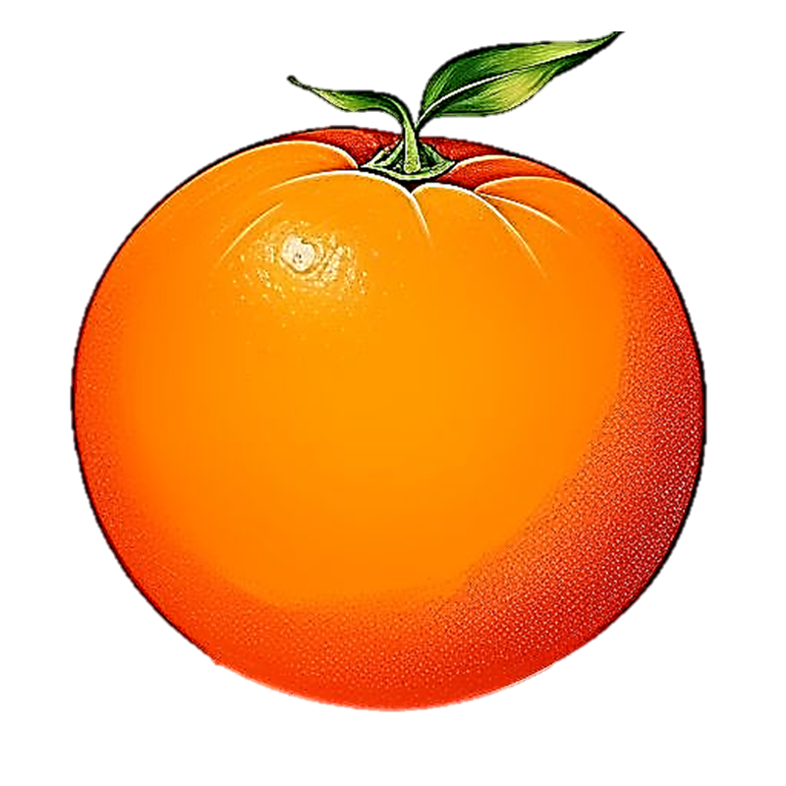
O o
Blossomings.github.io
Oo Oo Oo Oo Oo Oo
Oo Oo Oo Oo Oo Oo
Color Splash
Oo Oo Oo Oo Oo Oo

Slide 17
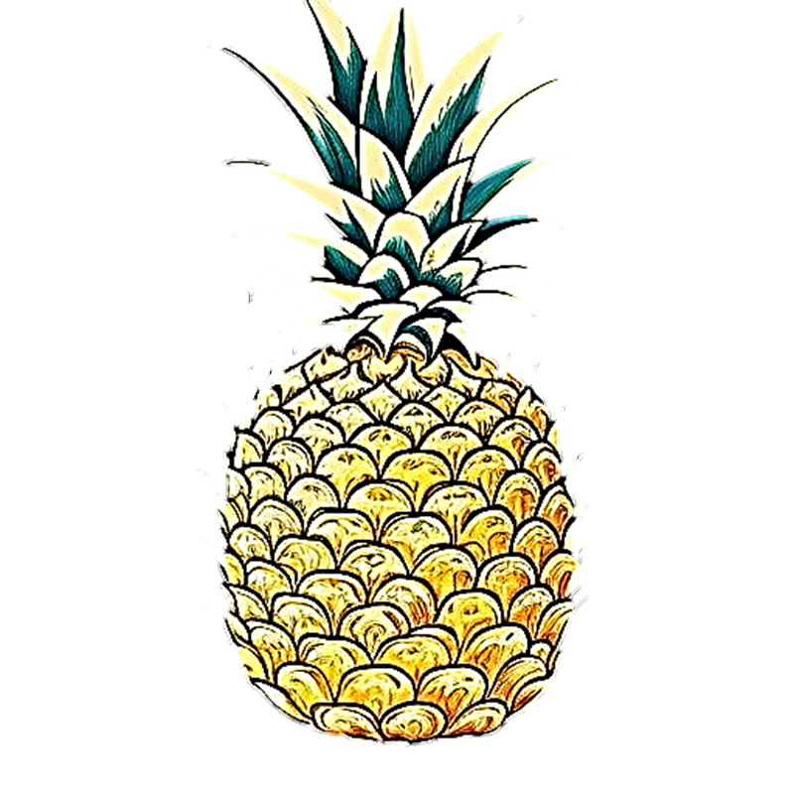
P p
Blossomings.github.io
Pp Pp Pp Pp Pp Pp
Pp Pp Pp Pp Pp Pp
Color Splash
Pp Pp Pp Pp Pp Pp

Slide 18
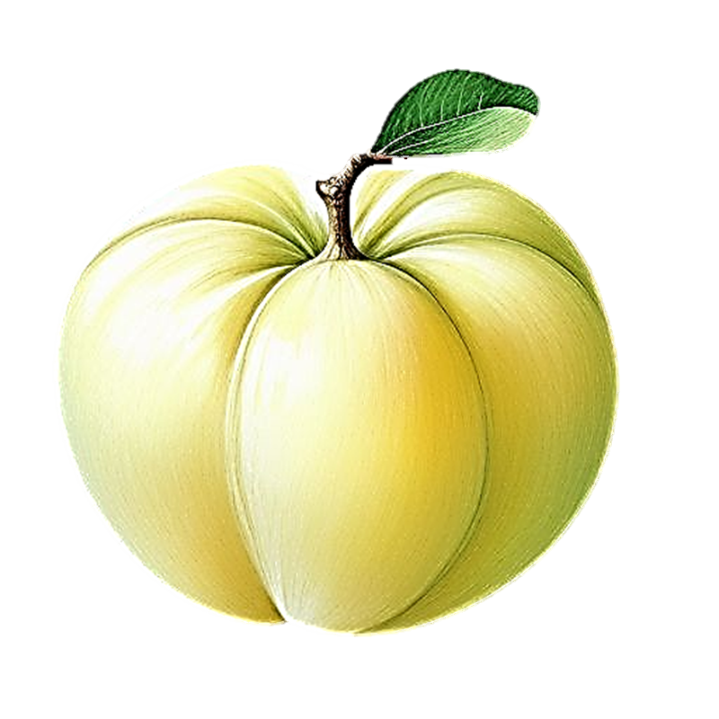
Q q
Blossomings.github.io
Qq Qq Qq Qq Qq
Qq Qq Qq Qq Qq
Color Splash
Qq Qq Qq Qq Qq

Slide 19
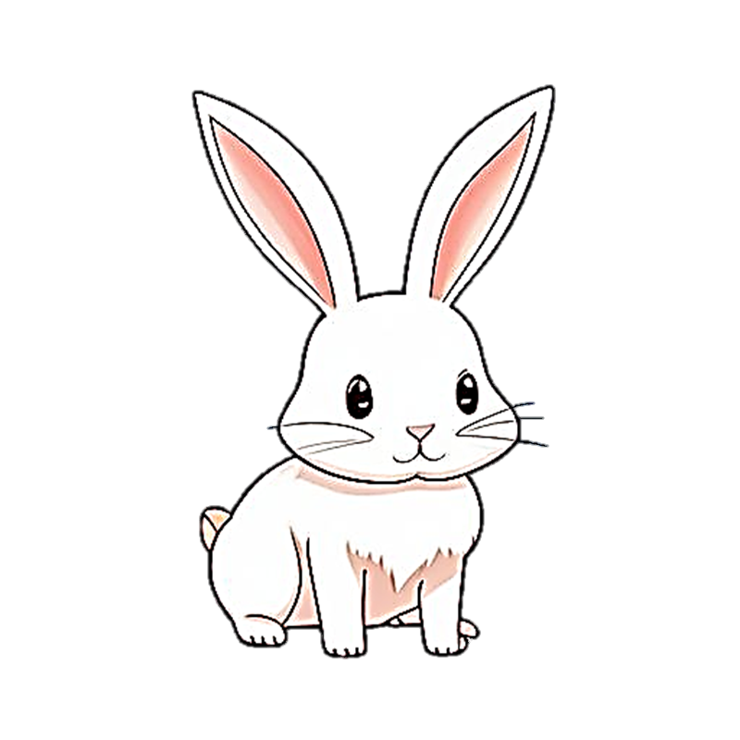
R r
Blossomings.github.io
Rr Rr Rr Rr Rr Rr
Rr Rr Rr Rr Rr Rr
Color Splash
Rr Rr Rr Rr Rr Rr

Slide 20
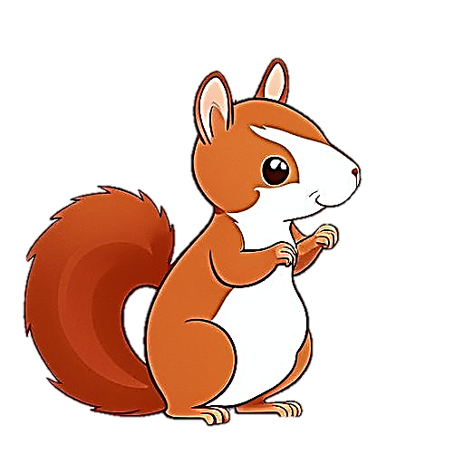
S s
Blossomings.github.io
Ss Ss Ss Ss Ss Ss
Ss Ss Ss Ss Ss Ss
Color Splash
Ss Ss Ss Ss Ss Ss

Slide 21
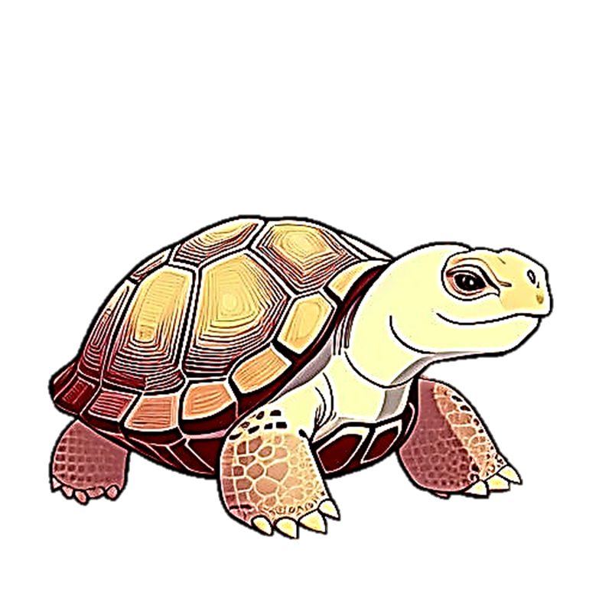
T t
Blossomings.github.io
Tt Tt Tt Tt Tt Tt
Color Splash
Tt Tt Tt Tt Tt Tt
Tt Tt Tt Tt Tt Tt

Slide 22
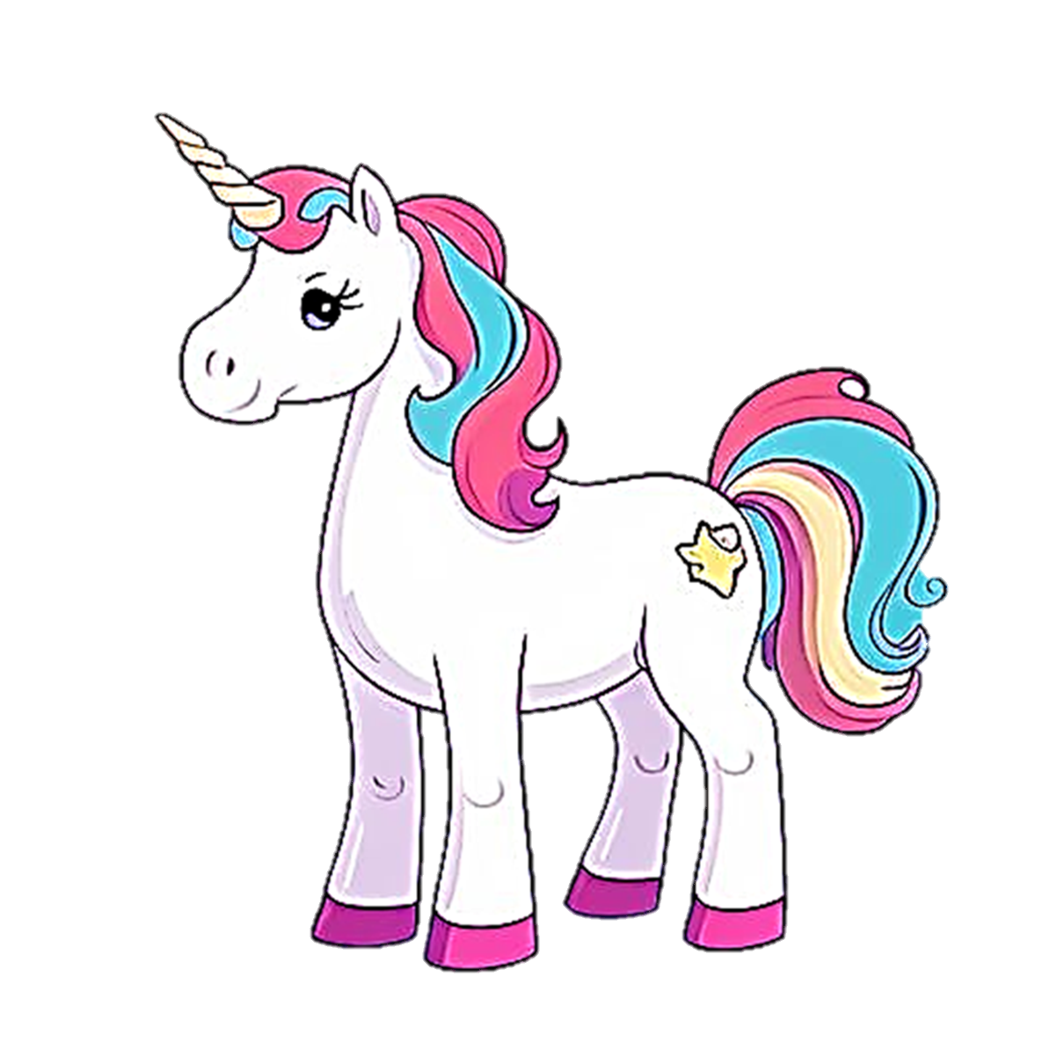
U u
Blossomings.github.io
Uu Uu Uu Uu Uu Uu
Uu Uu Uu Uu Uu Uu
Color Splash
Uu Uu Uu Uu Uu Uu

Slide 23

V v
Blossomings.github.io
Vv Vv Vv Vv Vv Vv
Vv Vv Vv Vv Vv Vv
Color Splash
Vv Vv Vv Vv Vv Vv

Slide 24

W w
Blossomings.github.io
Ww Ww Ww Ww Ww
Ww Ww Ww Ww Ww
Color Splash
Ww Ww Ww Ww Ww

Slide 25

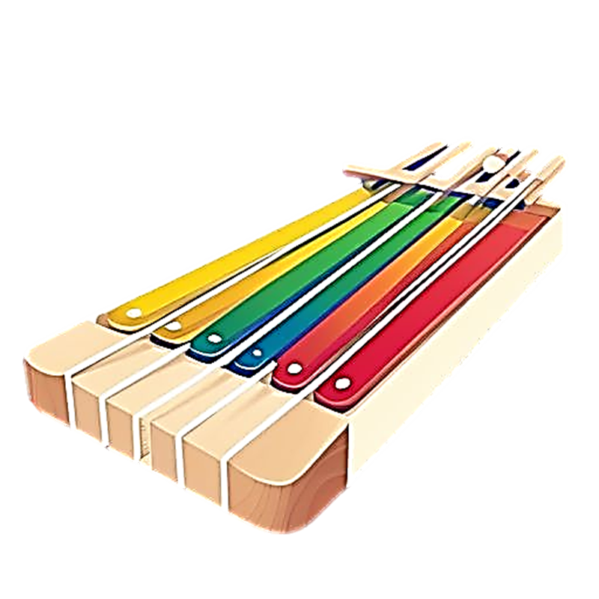


X x
Blossomings.github.io
Xx Xx Xx Xx Xx Xx
Xx Xx Xx Xx Xx Xx
Color Splash
Xx Xx Xx Xx Xx Xx

Slide 26
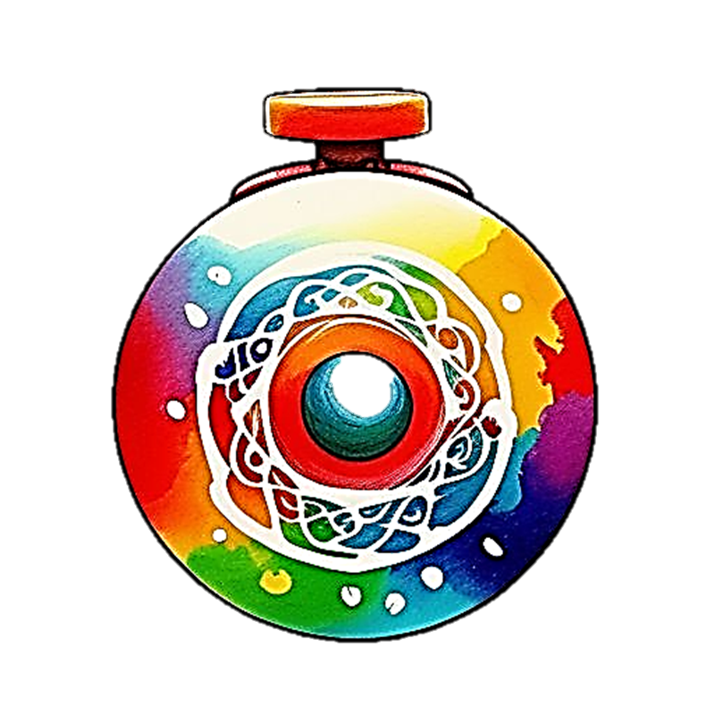
Y y
Blossomings.github.io
Yy Yy Yy Yy Yy Yy
Yy Yy Yy Yy Yy Yy
Color Splash
Yy Yy Yy Yy Yy Yy

Slide 27
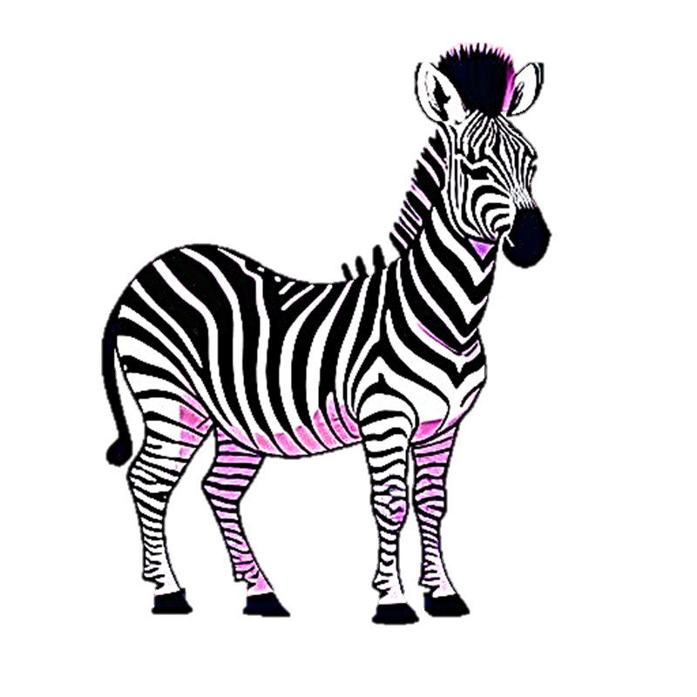
Z z
Blossomings.github.io
Zz Zz Zz Zz Zz Zz
Zz Zz Zz Zz Zz Zz
Color Splash
Zz Zz Zz Zz Zz Zz

